Slide 1

Switch Decision Statements
A switch statement is used to easily select one option from a number of options when making a decision
A switch value is compared to a list of values called cases. The switch value might be a variable, an expression, or a direct value
Whenever is found that the switched value is equal to a case value, the block of code associated with that case is executed

Slide 2
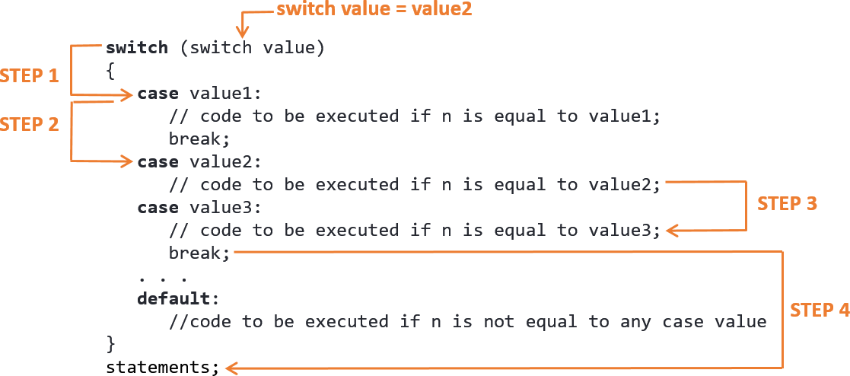
Switch Statement Syntax

Slide 3
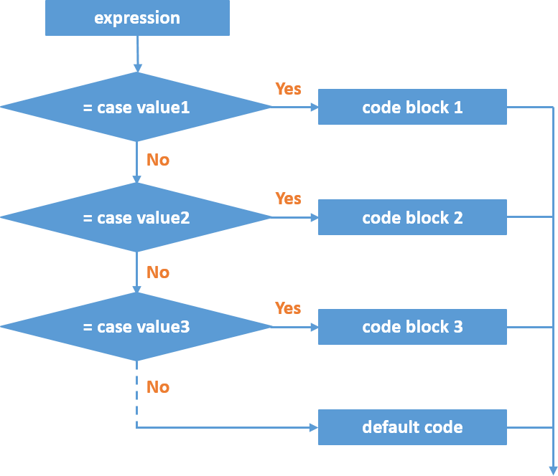
Switch Statement Flowchart

Slide 4
Switch Statement Flowchart
Example:
int i= 2;
switch (i)
{
case 1:
printf("too low");
break;
case 2:
case 3:
printf("good number");
break;
Default:
printf("too high");
}

